Slide 1
Lecture 4
air pollution & air quality and control

Slide 2
INDOOR AIR QUALITY
Indoor Environment
• Thermal Comfort
Air Quality
• Acoustic
• Light

Slide 3
Indoor Air quality
What is IAQ?
IAQ refers to the quality of air inside buildings represented by concentrations of pollutants and thermal conditions that affect the health comfort, and performance of occupants.
Concept of IAQ will talking about air conditioning and in air conditioning will talking about cooling or heating of air and necessary to talking about filtration of air and controlling of all contamination

Slide 4
Indoor Air quality
Why the IAQ is important?
People spend more than 90% of their time indoor
Human health
Better work outcome/productivity
High thermal comfort
Indoor air is 2 to 5 times more polluted than outdoor air

Slide 5
Thermal comfort
Thermal comfort standard

Slide 6
Thermal comfort

Slide 7
Thermal comfort
Notes:
Predicted mean vote Predicted percentage dissatisfied

Slide 8
Thermal comfort

Slide 9
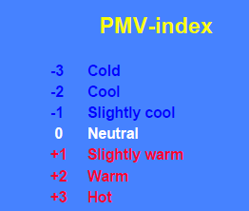
Thermal comfort

Slide 10
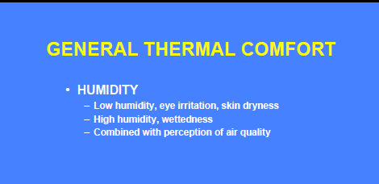
Thermal comfort

Slide 11
Thermal comfort

Slide 12
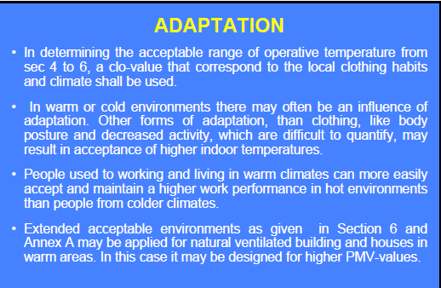
Thermal comfort

Slide 13
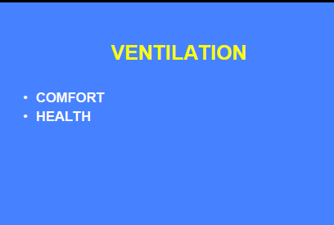
Ventilation

Slide 18
Pollution source control and ventilation improve health, comfort and productivity

Slide 23
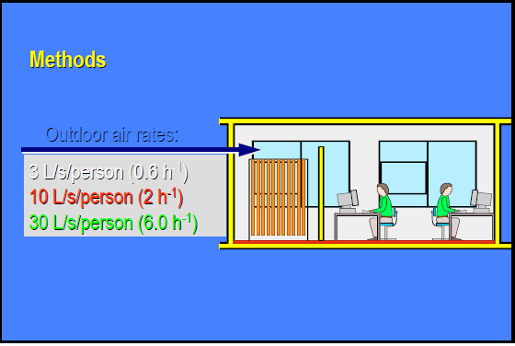

Slide 24
